Slide 1



Add logo(s) here (e.g., Country, Health Dept. or TB Program)
Latent TB Infection “Sleeping TB”

Slide 2
Latent TB Infection
“Sleeping TB”

Slide 3
How to use this flipbook
Instructions for Health Care Personnel
The purpose of this flipbook is to help health care personnel provide education on latent TB infection, which is also called “sleeping TB”.
Sitting across from one another or side by side:
  Color panels are to be viewed by the client(s).
  Black and white panels are to be viewed by health care personnel.
Health care personnel should read the text on the black and white panels to the client(s). Reading hints:
  Take your time − read slowly.
  Stop and ask the client for questions.
  Make this interaction positive and pleasant. Smile!

Slide 4
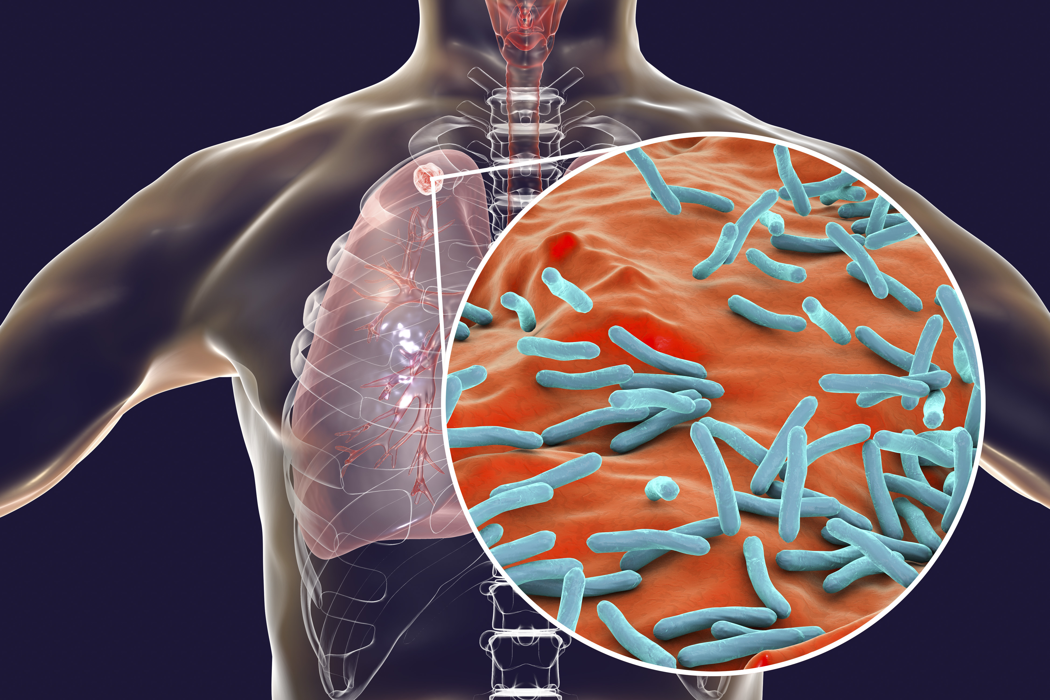
What is TB?
Tuberculosis (TB) is a disease caused by a very tiny germ.
TB can hide in your body, inactive or sleeping. This is called latent TB infection or sleeping TB.
Latent TB Infection = Sleeping TB
1

Slide 5
What is TB?
TB is short for tuberculosis.
The TB germ is very, very small. It is so small it can float in the air when someone with TB disease coughs.
People who spend time with someone with active TB disease can breathe in the TB germs.
TB can hide in your body, inactive or sleeping. This is called latent TB infection. It is also called “sleeping TB” because the germs will stay asleep as long as your body can fight them off.
2

Slide 6
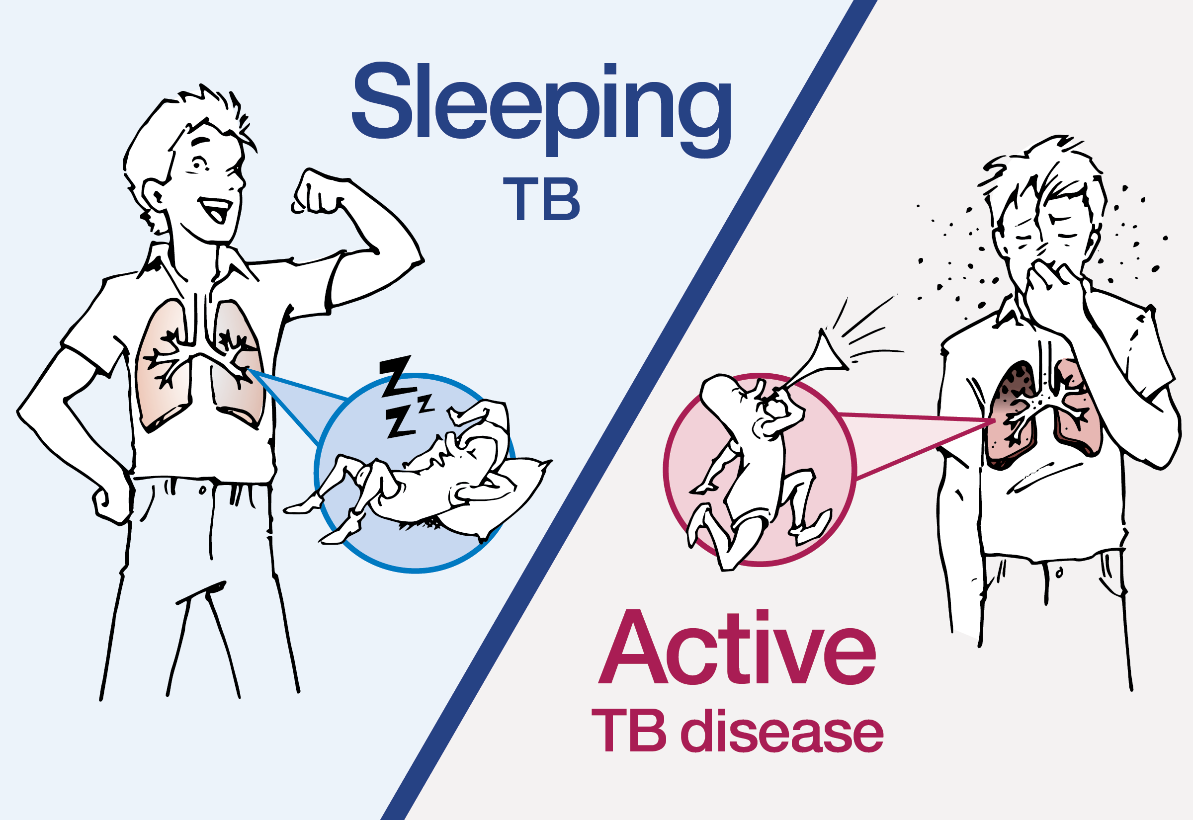
What is sleeping TB?
Sleeping
TB
A person with sleeping TB
does not feel sick and cannot spread TB germs to others.
Active
TB disease
3

Slide 7
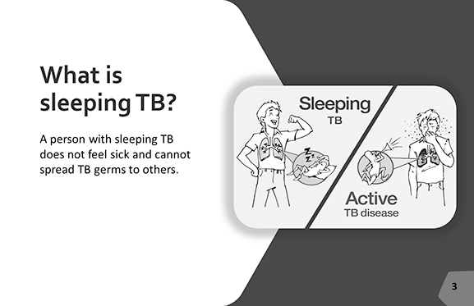
What is sleeping TB?
A bump on your arm after your TB skin test means you breathed in TB germs at some time in your life.
You may have breathed in the TB germs just a few weeks ago, or maybe many years ago.
Once the TB germs are breathed in, they can remain active and cause TB disease but most of the time, the germs go to sleep and become inactive.
This type of inactive TB is called “latent TB infection” or sometimes we call it “sleeping TB”.
Because the germs are sleeping, the person does not feel sick and cannot spread the germs to others.
We cannot predict when, or if, the TB germs will wake up and possibly make you sick.
4

Slide 8
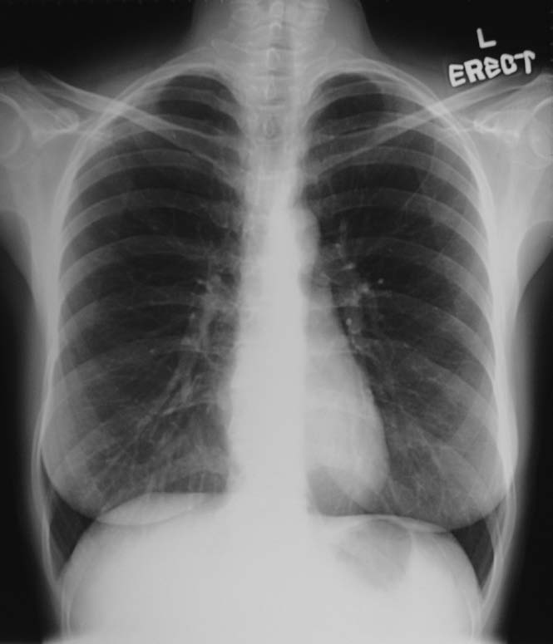
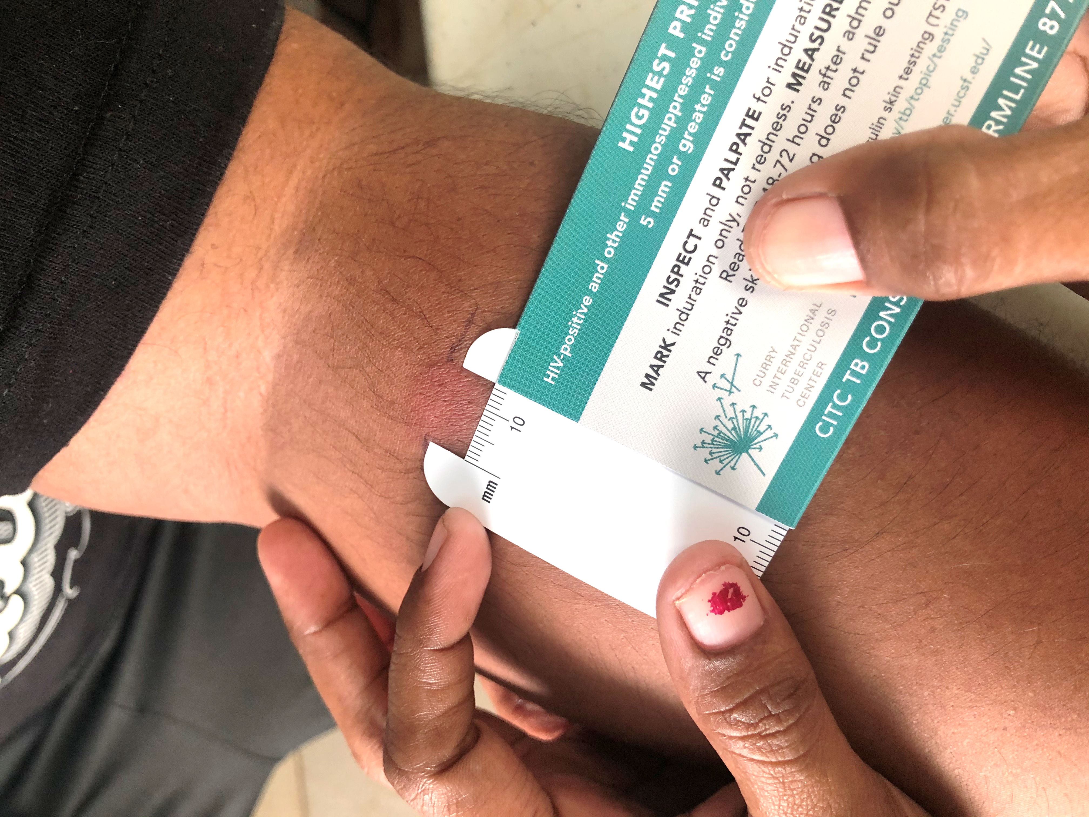
How do I know that I have sleeping TB?
There was a bump on your arm after your TB skin test.
And the picture of your lungs did not show TB disease.
5

Slide 9
How do I know that I have sleeping TB?
There was a bump on your arm after your
TB skin test.
This means you have TB germs in your body.
The TB germs can sleep in your body for years!
The picture of your lungs (chest X-ray) did not show TB disease.
This means the TB germs are sleeping.
6

Slide 10
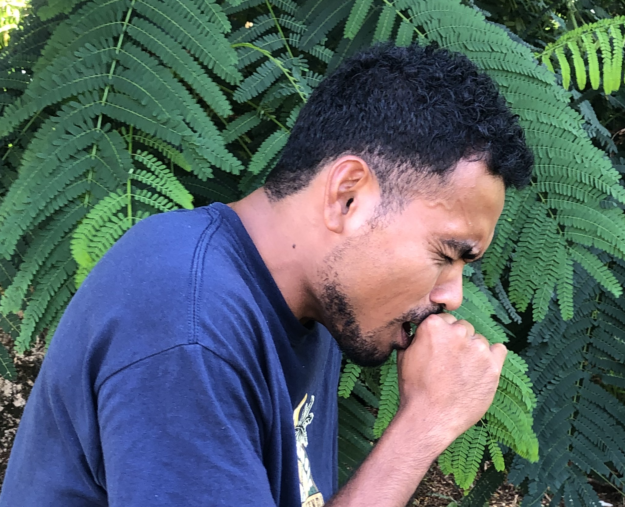
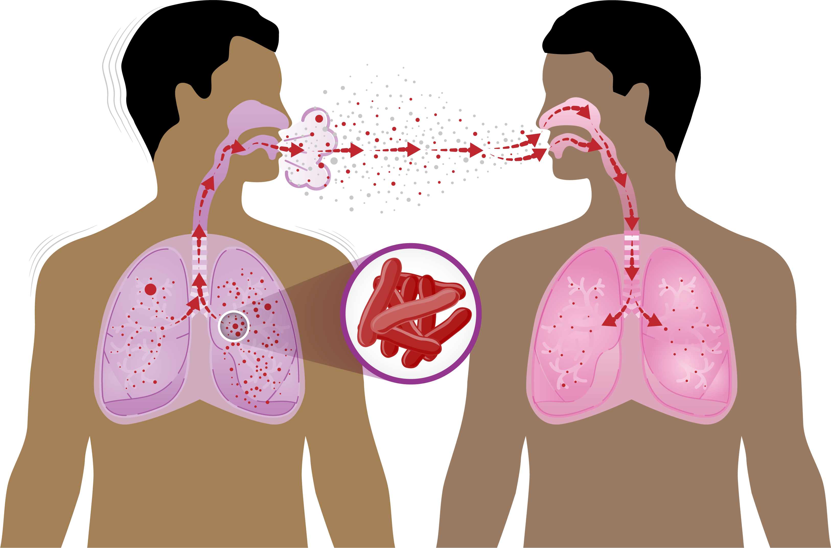
How did I get TB germs?
You breathed in the TB germs when you spent time with someone who was sick with TB disease (cough, fever, weight-loss) and was not taking medicine.
7

Slide 11
How did I get TB germs?
You breathed in the TB germs and became infected when you spent time with someone with TB disease.
Someone with TB disease may feel sick with cough, fever, and weight loss.
Anyone who spends a lot of time near someone sick with TB can breathe in TB germs from the air.
TB germs are coughed out into the air by someone sick with TB disease and the germs remain floating in the air for some time.
The most common way TB is spread is by living in the same household or spending a lot of time with someone who is sick with TB disease before they start TB medicine.
Misconceptions about
how someone can get TB:
TB is not spread by someone casting a spell on another.
TB is not spread by someone sharing utensils and clothing.
TB is not spread by
shaking hands.
TB is not spread by kissing.
8

Slide 12
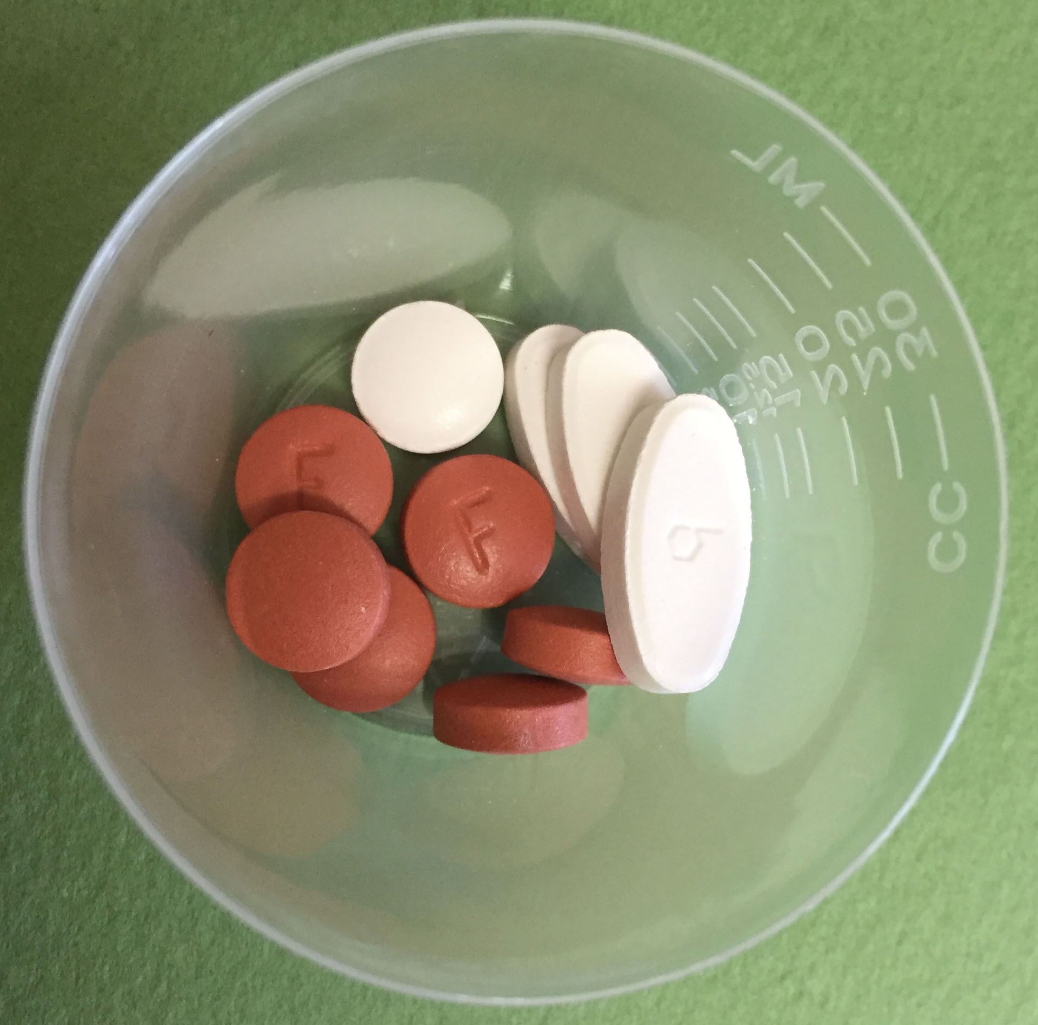
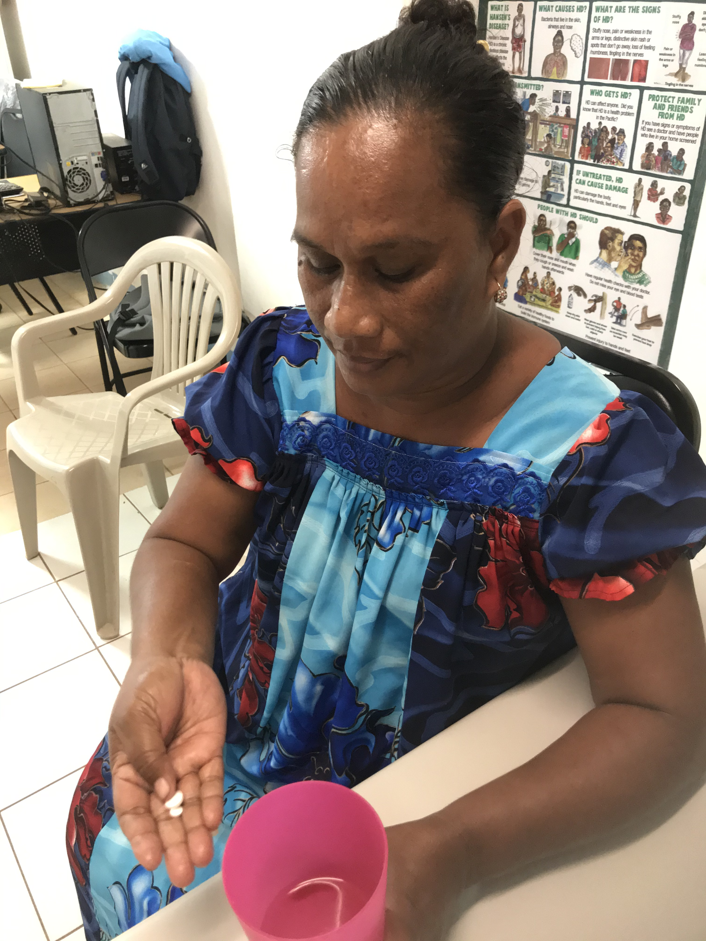
Can I get rid of the TB germs?
Yes! There is medicine that can get rid of the TB germs.
9

Slide 13
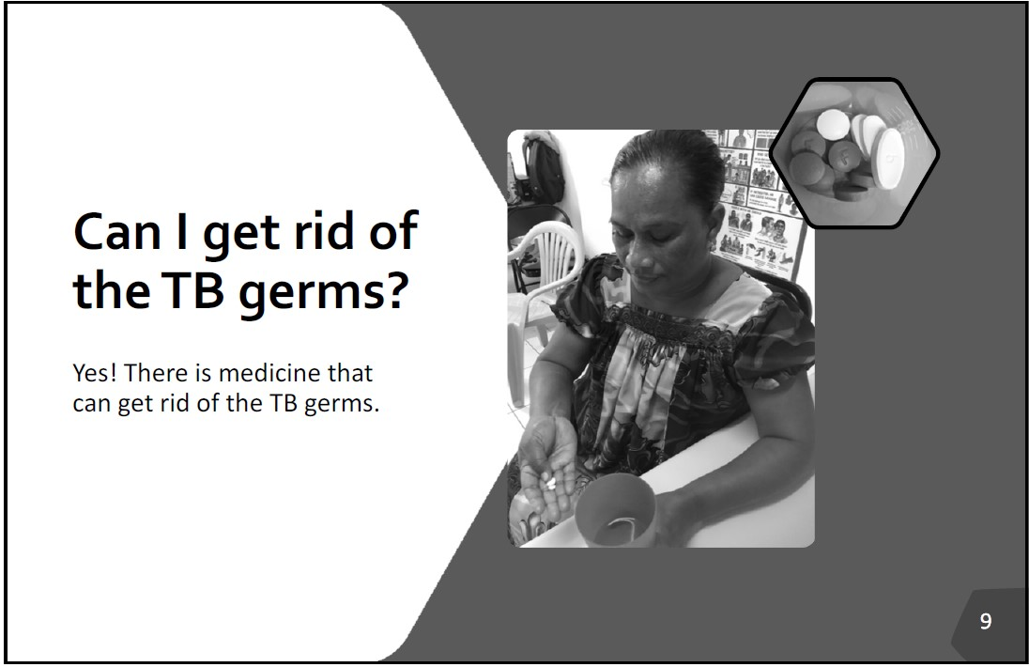
Can I get rid of the TB germs?
The good news is that there is medicine that can get rid of the TB germs.
Your doctor will help you decide which medicines will be best for you.
Some medicines are taken once a week and some are taken daily.
To get rid of the TB germs, you must take all the medicine until it is finished.
10

Slide 14
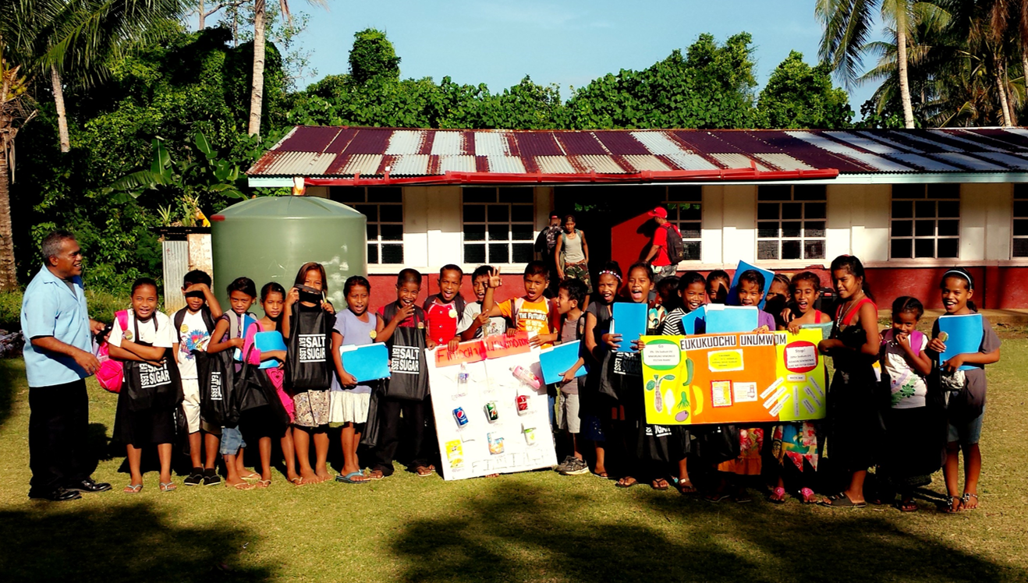
Why should
I take the medicine if I don’t feel sick?
Taking the medicine is the best way to kill the TB germs in your body.
Taking the medicine is the best way to protect your family
and community.
11

Slide 15
Why should I take the medicine if
I don’t feel sick?
Taking TB medicine is the best way to kill the TB germs in your body.
If you don’t take the TB medicine, the TB germs can wake up later on and make you very sick with TB disease.
If you become sick with TB disease, you can pass TB to your family, friends and other people you spend time with.
It is also easier to treat “sleeping TB”.
12

Slide 16
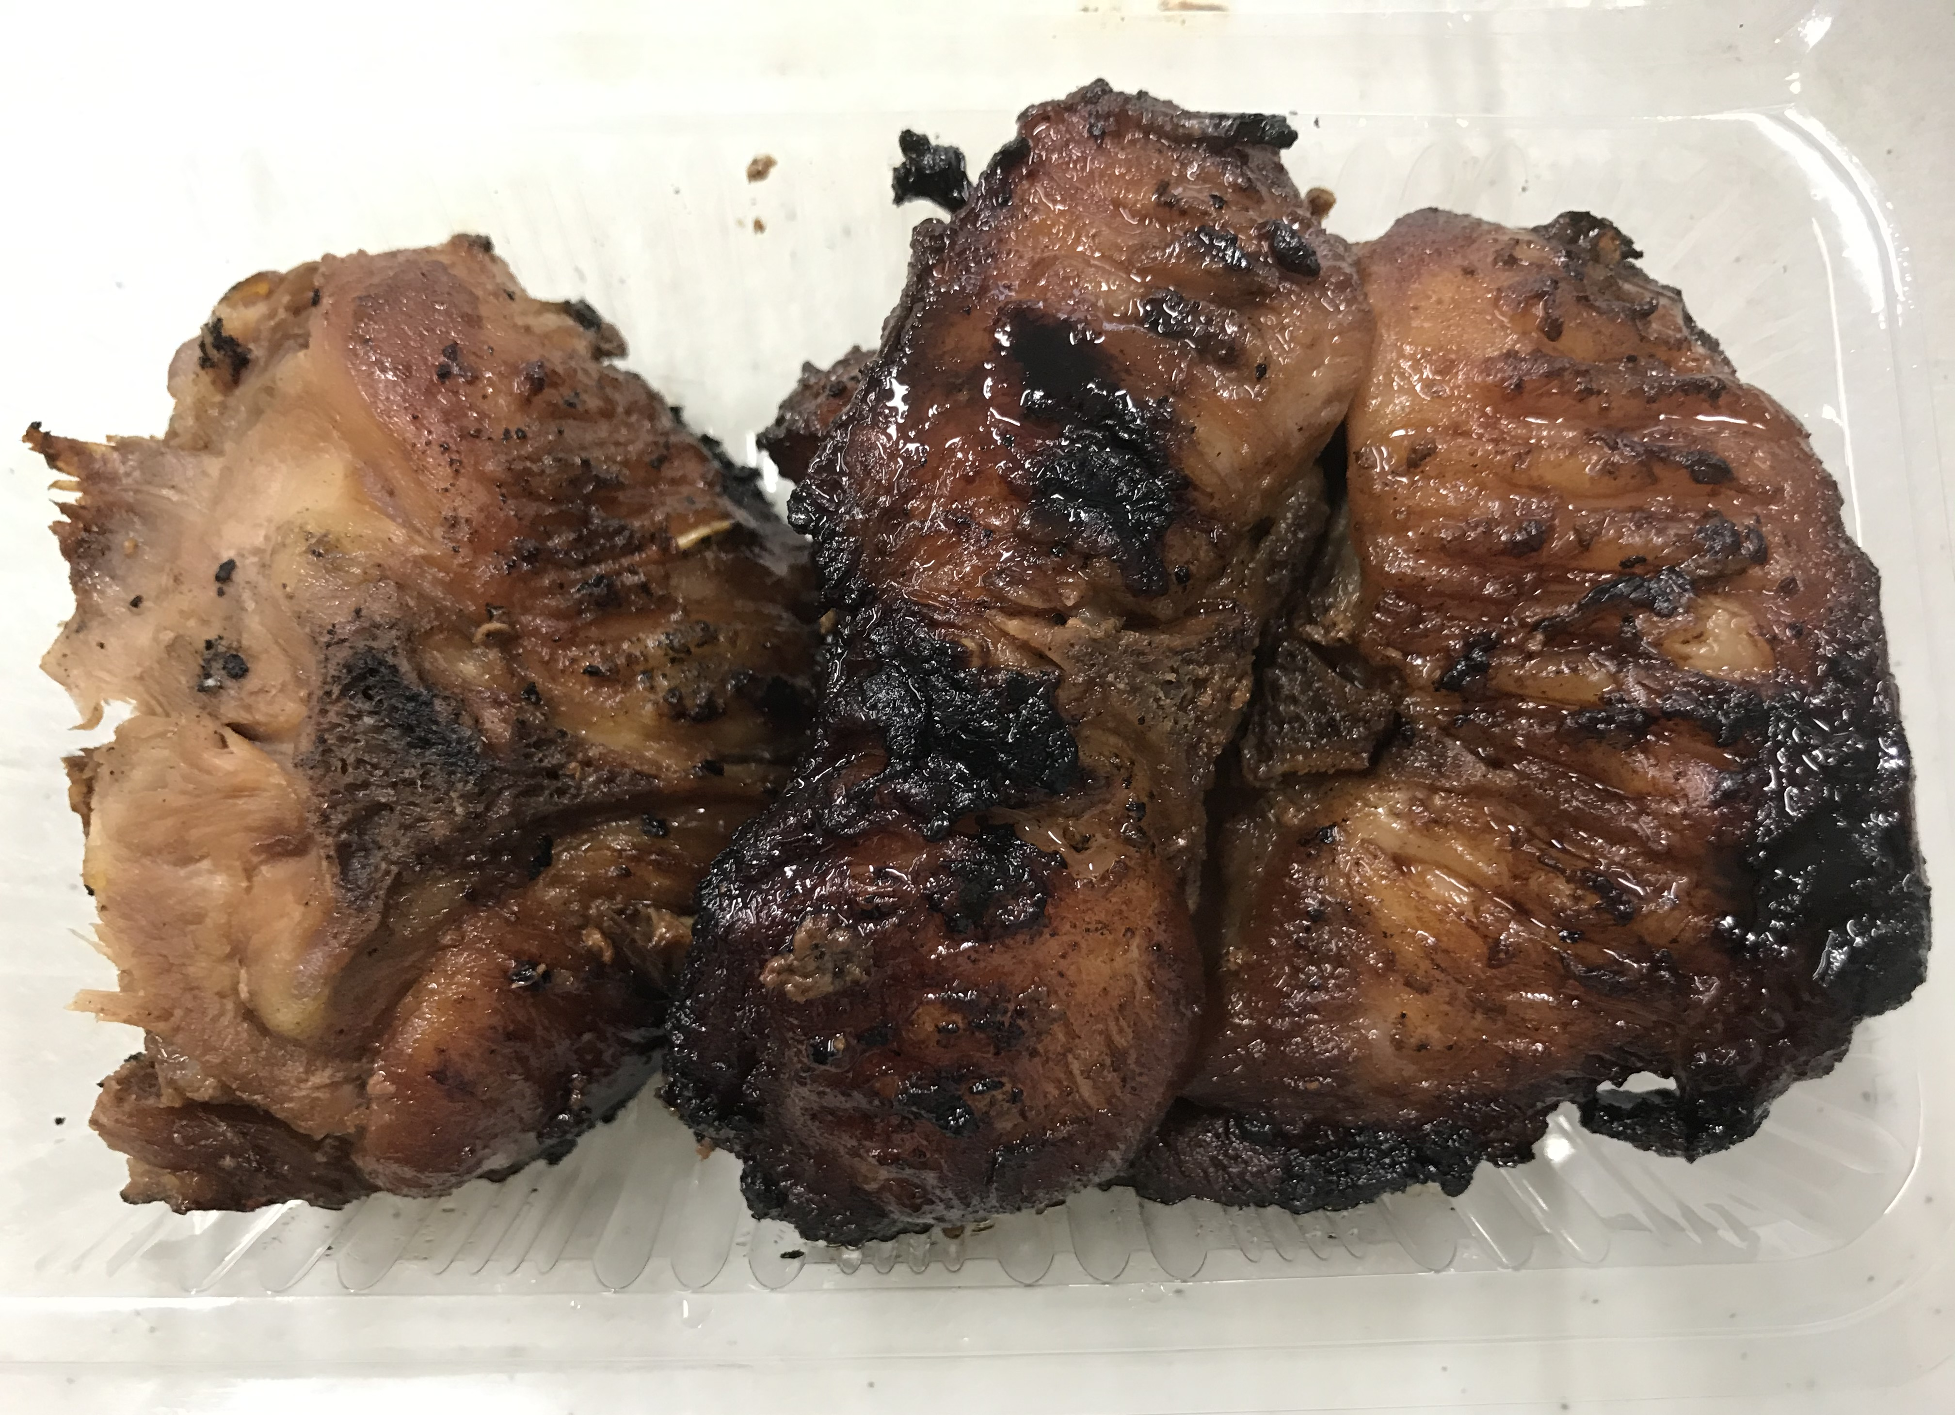
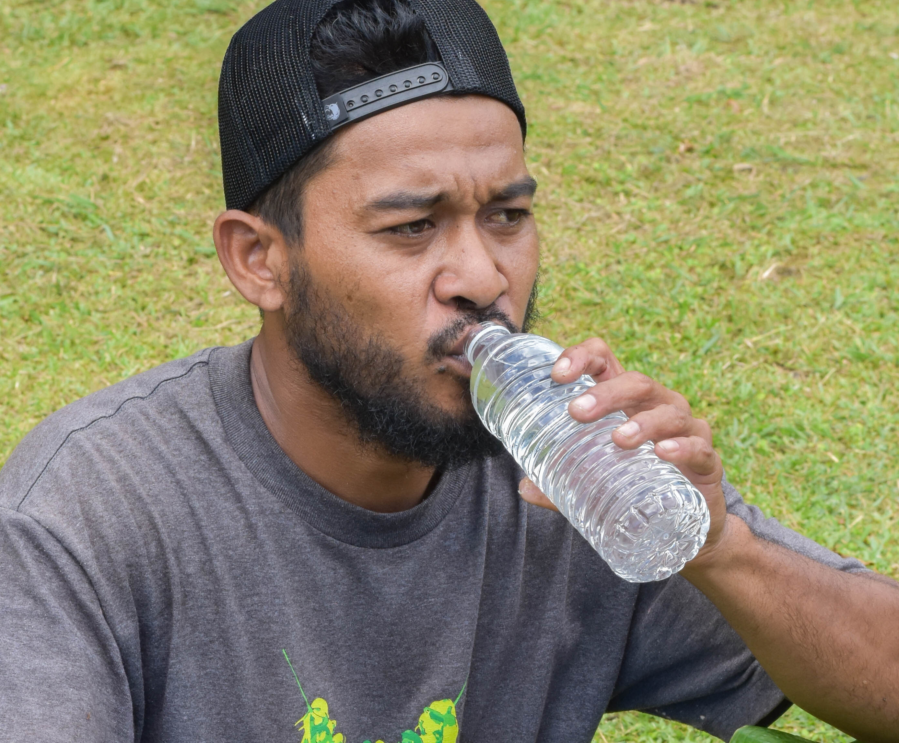
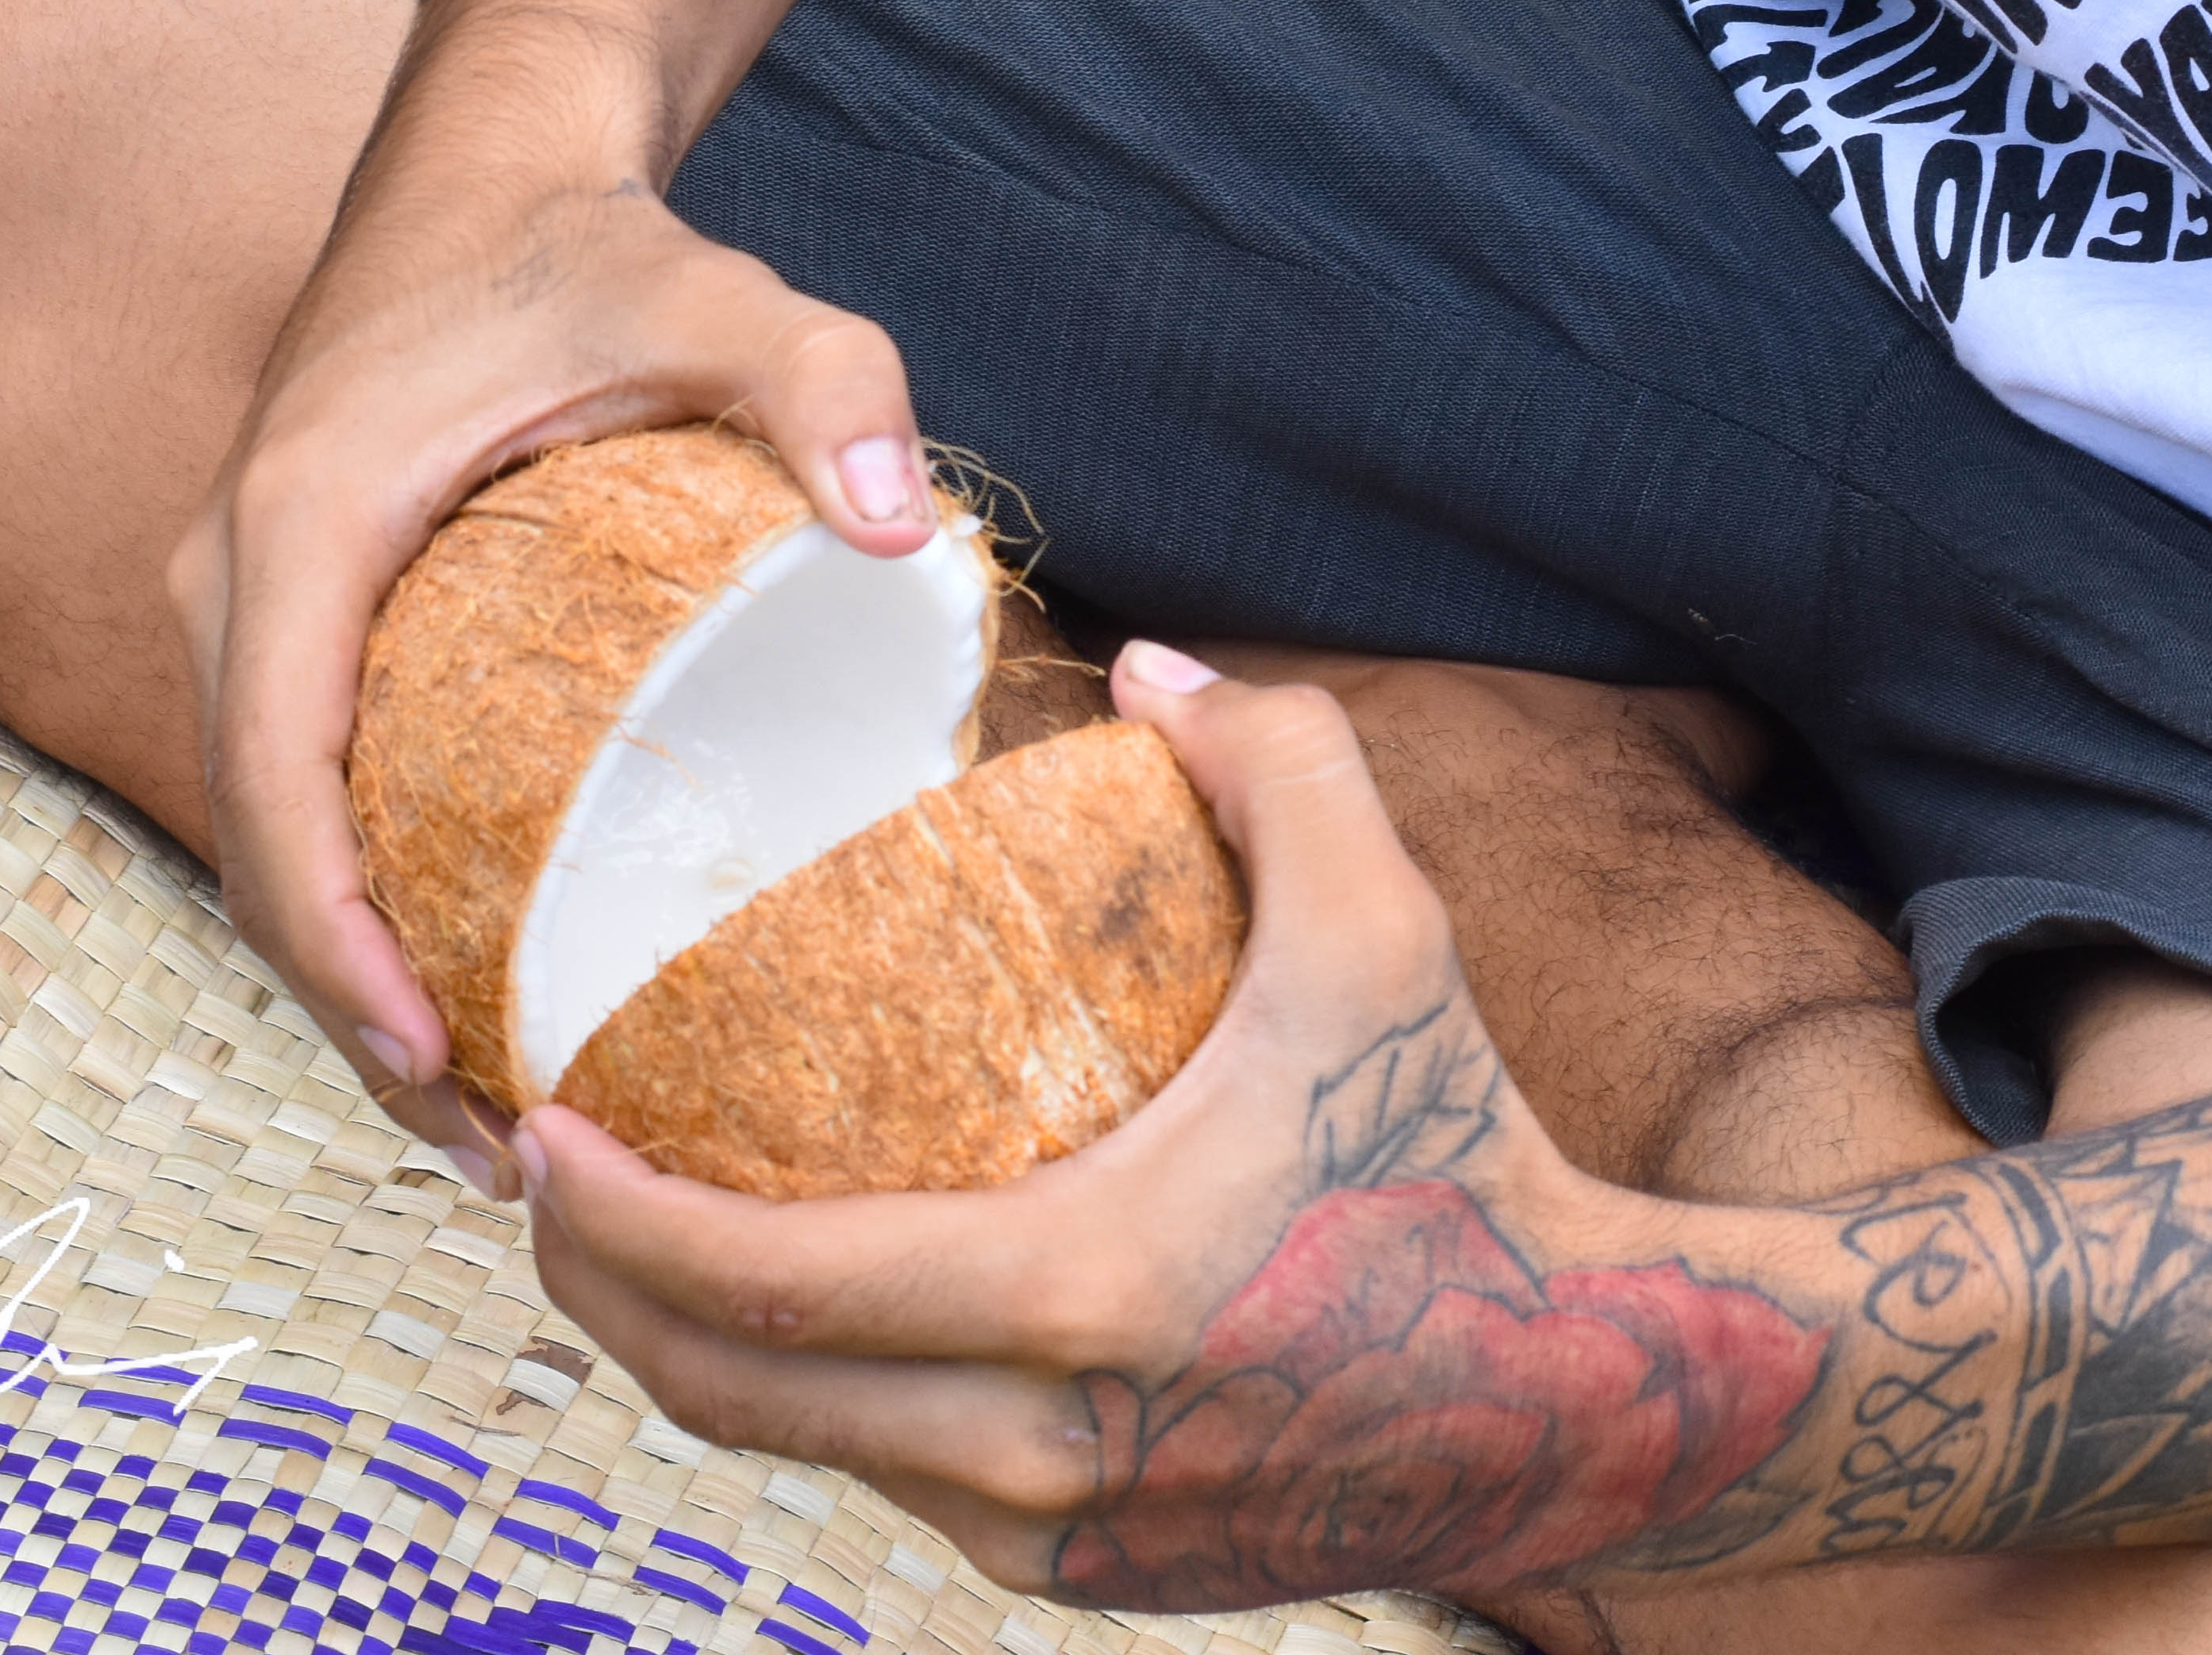
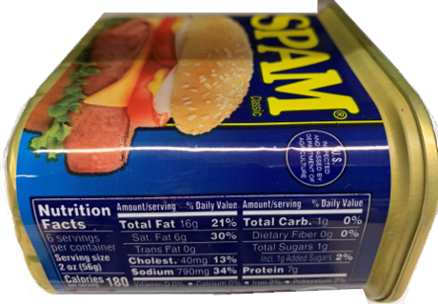
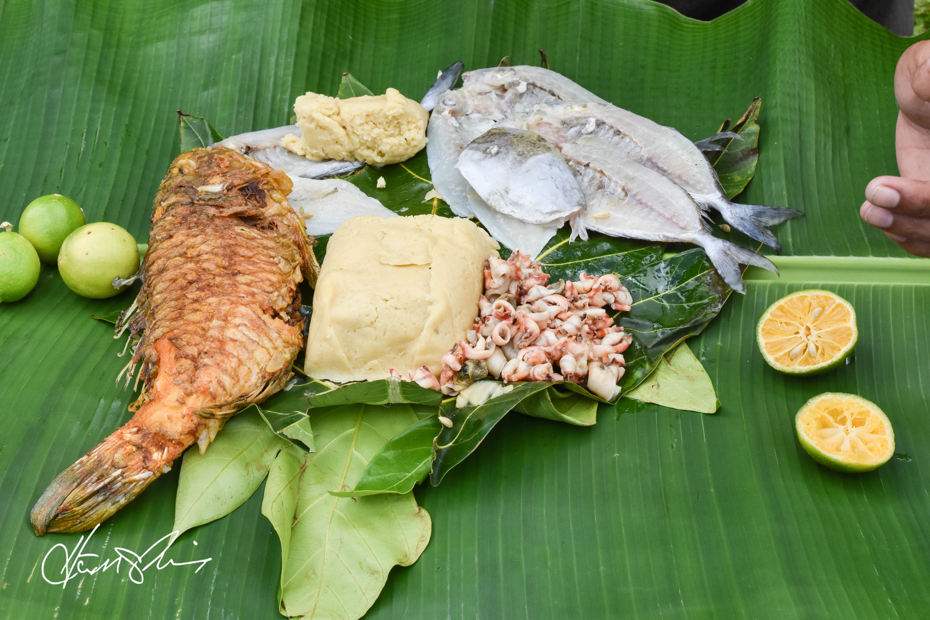
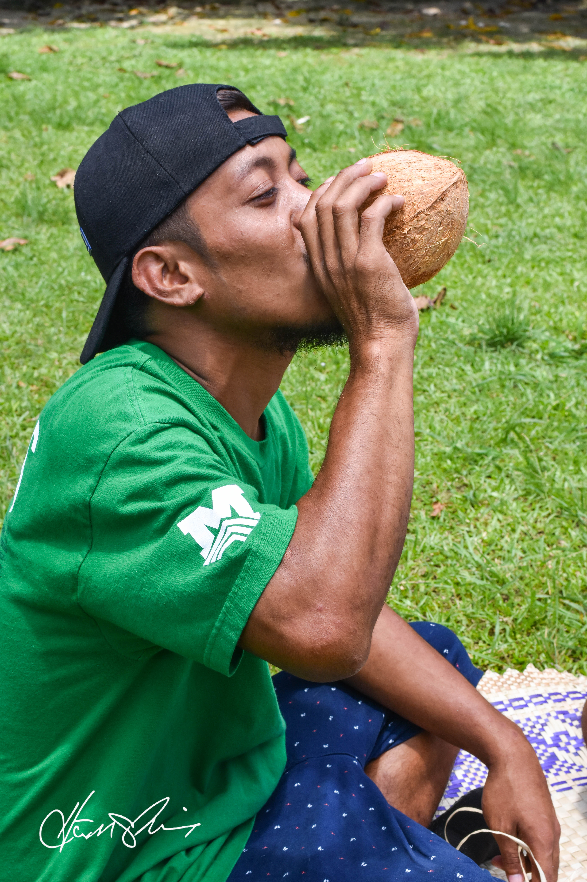

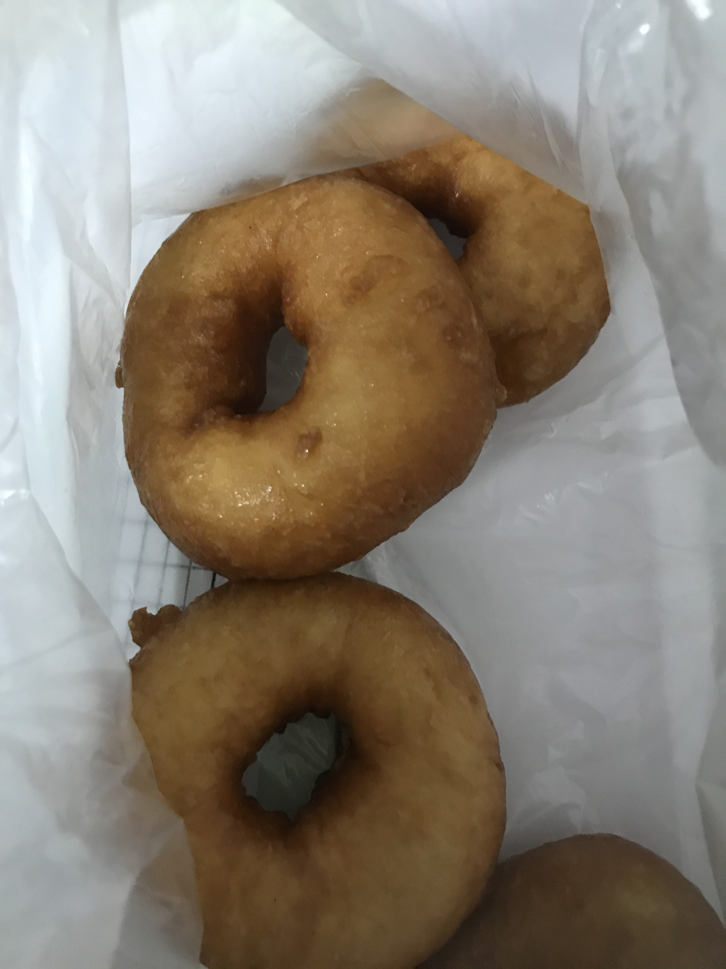
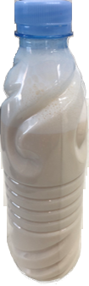
What should I do and not do while taking the medicine for sleeping TB?
GOOD
AVOID
Local homemade alcohol
13

Slide 17
What should I do and not do while taking the medicine for sleeping TB?
Things that are good to do while taking the medicine:
It is important to drink plenty of water while taking
the medicine.
It is ok to eat a small amount of food with
your medicine.
Some foods and drink are not good to take with the medicine as it may cause a problem. It is best if you avoid:
Oily or greasy foods on the day you take your medicine as the medicine might not work as well.
Alcohol as it may cause a problem with your liver while you are taking the medicine.
14

Slide 18
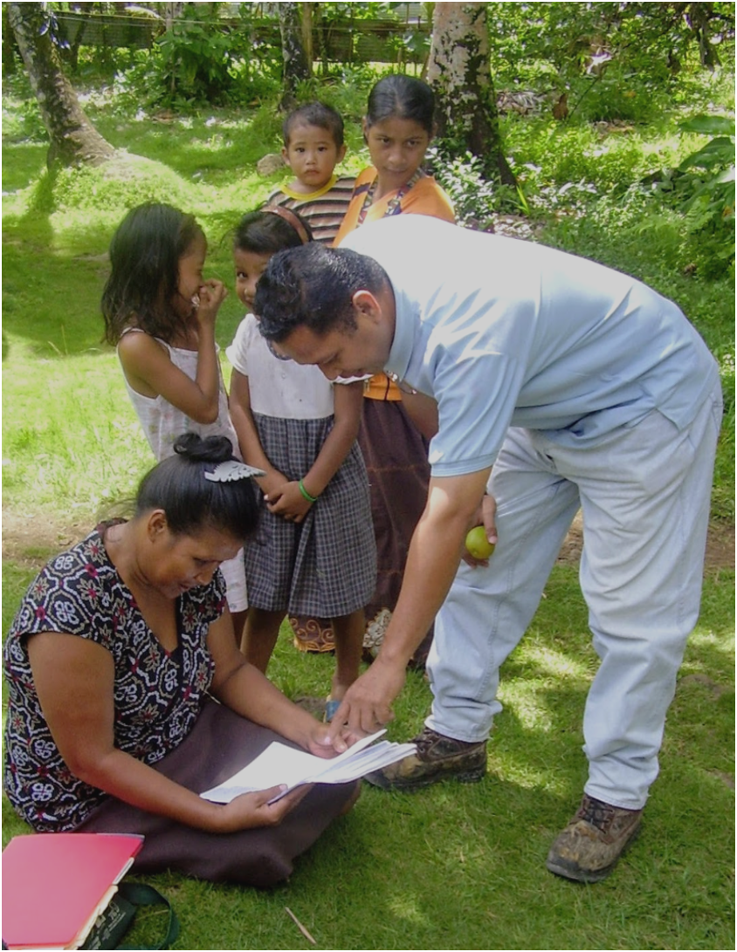
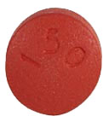


What should
I know about the medicine?
Urine, tears, saliva and sweat will turn a red/orange color on days you take the red tablets or capsules.
15

Slide 19
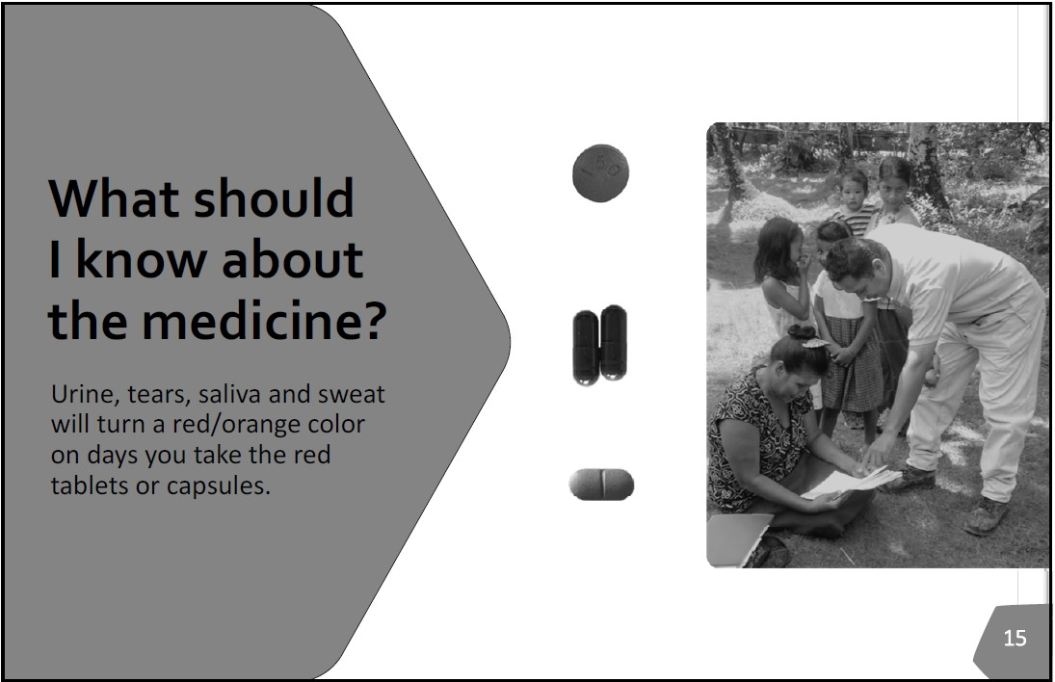
What should I know about the medicine?
[Example pictures of red medicines shown in center.]
[NOTE to Health Care Personnel: This slide can be skipped if client is not taking the red colored medicine.]
It is normal for your urine, saliva (spit), tears and sweat to turn a reddish/orange color on the days you take the red colored medicine (tablet or capsule). This will go back to normal when you finish your treatment.
16

Slide 20
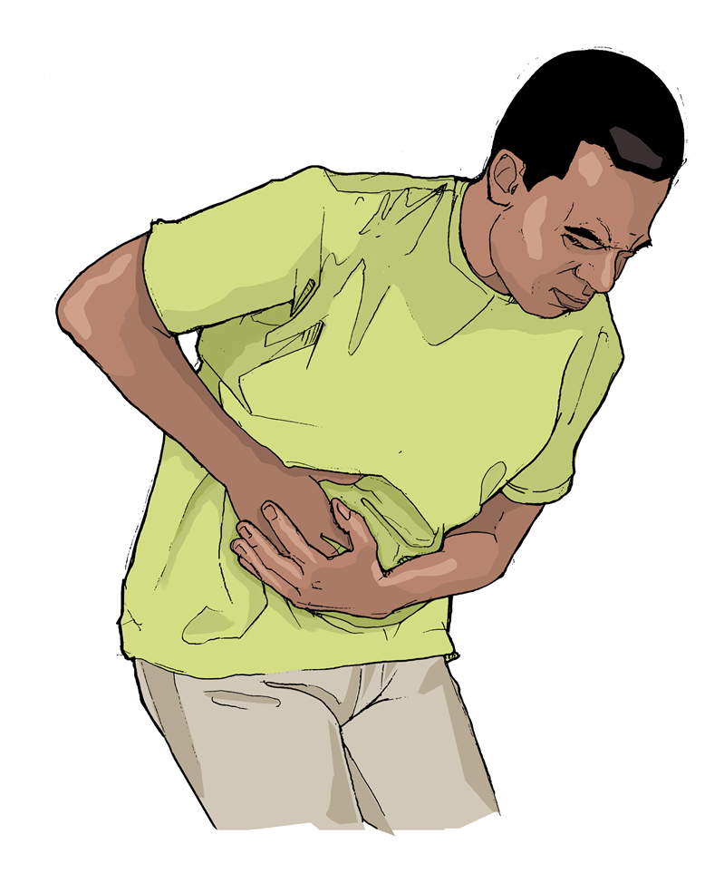
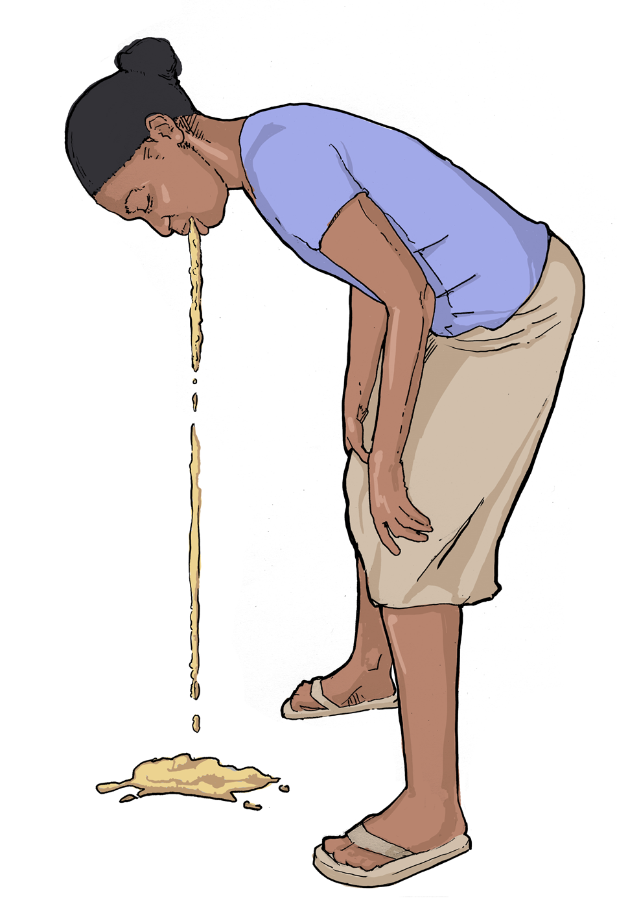
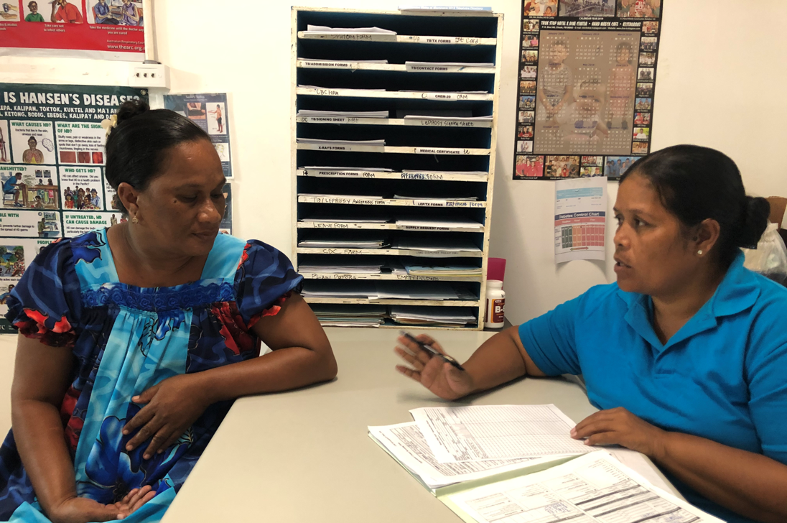
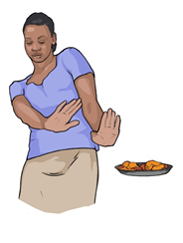
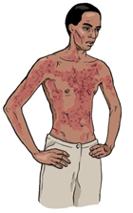
Are there any side effects of the medicine?
Upset stomach
Tell the clinic staff if the medicine makes you feel sick.
Nausea/vomiting
Loss of appetite
Skin rash
17

Slide 21
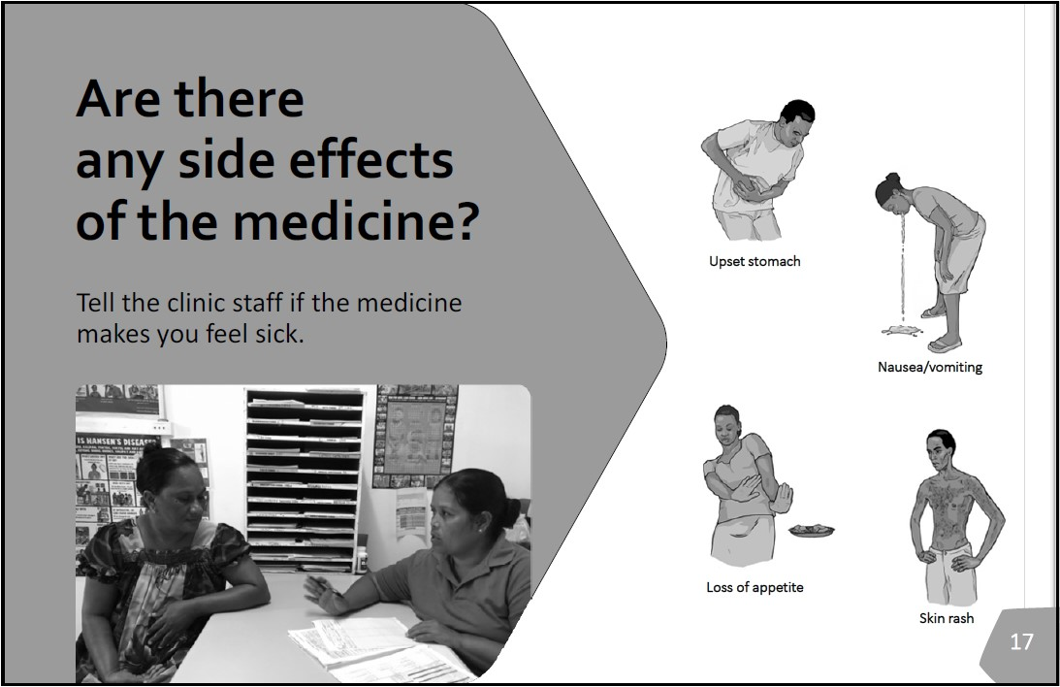
Are there any side effects of the medicine?
Most people have no side effects from this medicine.
Possible problems while taking the medicine include:
  feeling very tired
  upset stomach
  vomiting
  loss of appetite
  skin rash
If you have any one of these problems, let TB clinic staff know right away.
Your doctor might want to do a blood test while you are taking this medicine to make sure you are not having any problems with your liver.
Your doctor will let you know if there is another medicine you can take if you have a problem with the first one.
18

Slide 22
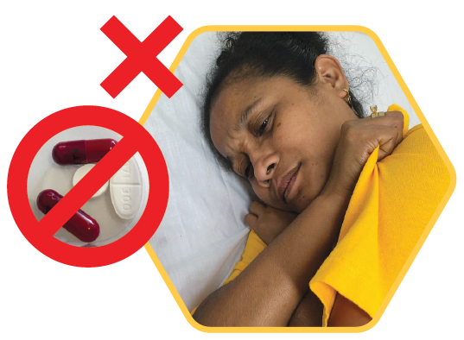
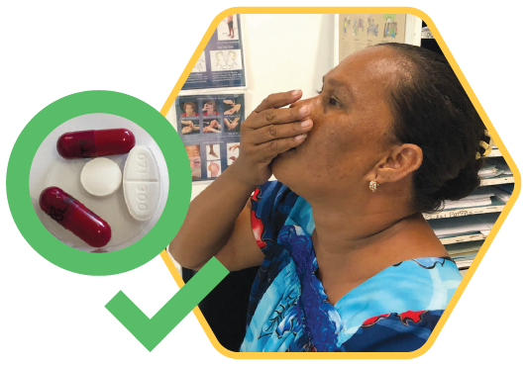
What could happen if I don’t finish all my medicine?
Taking the TB medicine now can stop the TB germs from waking up and making you sick later.
To protect yourself, it is important to take all the medicine!
19

Slide 23
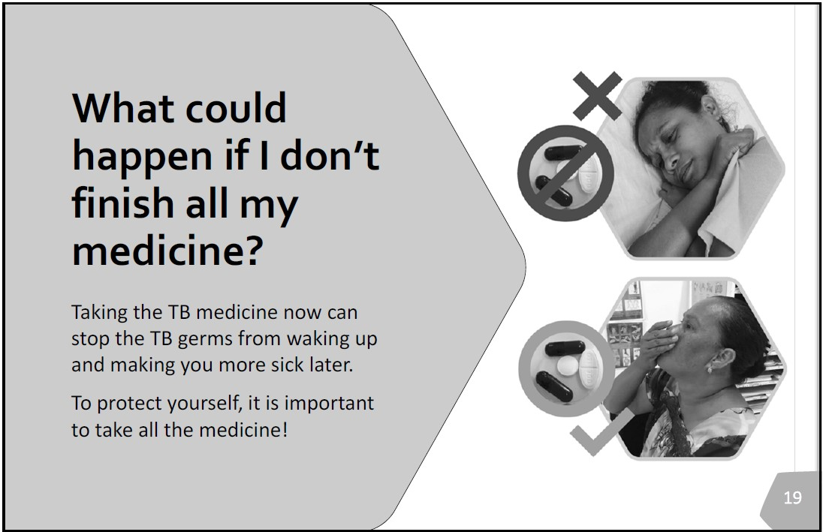
What could happen if I don’t finish all my medicine?
If you don’t take all the medicine the TB germs will remain in your body.
The TB germs may wake up and become active later on.
Finishing all the medicine now gives you the best chance to prevent getting sick with TB later.
20

Slide 24
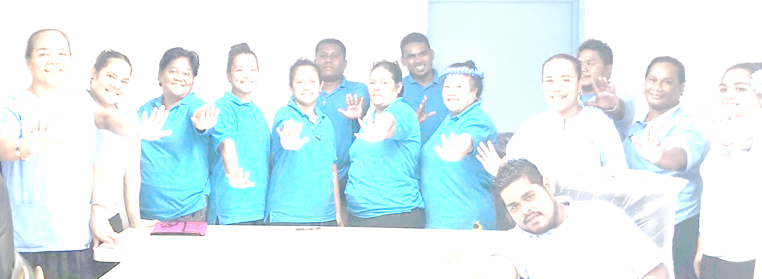
Insert local image of your team here
Working Together to
Eliminate TB
21

Slide 25
Working Together to Eliminate TB
[Ask if any questions about the information that was shared.]
21
22

Slide 26
The development of this product was made possible through a collaboration
with the Chuuk State TB and Hansen’s Disease Program, the Federated States of Micronesia National TB Program, the Centers for Disease Control and Prevention (CDC), and the Curry International Tuberculosis Center (CITC).
Acknowledgements
Image Credits
Cover
photo: Hirouki Mori
Page 1
illustration: Kateryna Kon / Adobe Stock
Page 3
illustration: Southeastern National TB Center (SNTC)
Page 5
photo: Nefertti David
x-ray: Curry International TB Center (CITC)
Page 7
photo: Nefertti David
illustration: Centers for Disease Control and Prevention (CDC)
Page 9
photo: CITC
Page 11
photo: Dr. Dorina Fred
Page 13
photos on left: Hirouki Mori
photos on right:
beer & yeast: Nefertti David
turkey tails & donuts: CITC
Page 15
photo: Dr. Richard Brostrom
medication: CITC
Page 17
photo: Nefertti David
illustration: CDC
Page 19
photo: Nefertti David
medication: CITC
Page 21
photo: Nefertti David
CITC is a project of the University of California, San Francisco, funded by the CDC. The development, ﬁeld testing, and design, of this ﬂipbook was funded through Cooperative Agreement NU52PS910163-03. The views expressed in written materials or publications do not necessarily reﬂect the ofﬁcial policies of the Department of Health and Human Services, nor does the mention of trade names, commercial practices, or organizations imply endorsement by the U.S. Government.
This PowerPoint file is available in a modifiable format to enable local adaptation. Permission is granted for nonproﬁt educational use and duplication, but we ask
that acknowledgements of design and image credits be retained where used.
Design: Edi Berton Design
23

